Slide 1
3 Axis Pin Dev. Update
Week #16

Slide 2


Rigid Frame Progress
12 outer frames
Still not sure about how to incorporate inner frames, since there is no possible stringing for spacing < 4.25 mm (not an analytical solution)
Pulley
Motor

Slide 3
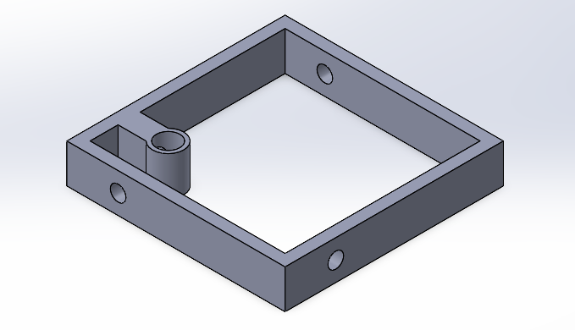
Outer Frame V1:
Threading Hole Diameter = 1 mm
thickness: 0.75 mm
h = 2.5 mm
10 mm
Problems:
Too compliant in horizontal plane
Hole near pin is wacky

Slide 4
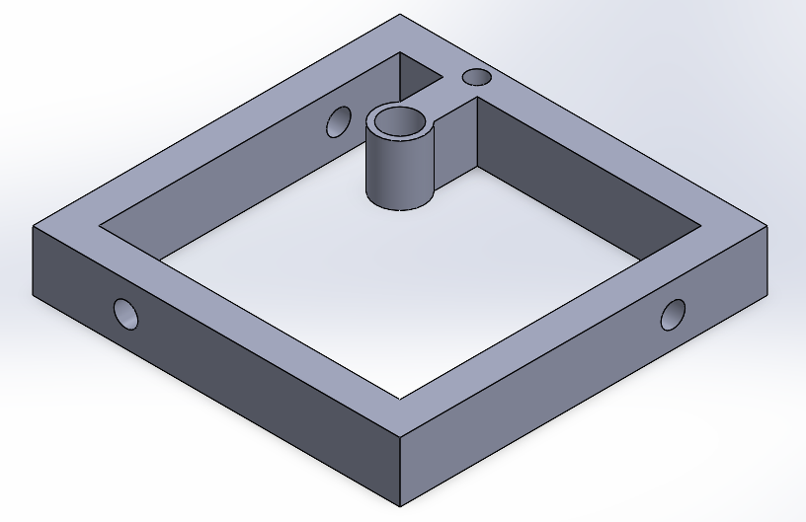
Outer Frame V2:
Threading Hole Diameter = 1 mm
thickness: 1.5 mm
h = 2.5 mm
10 mm

Slide 5
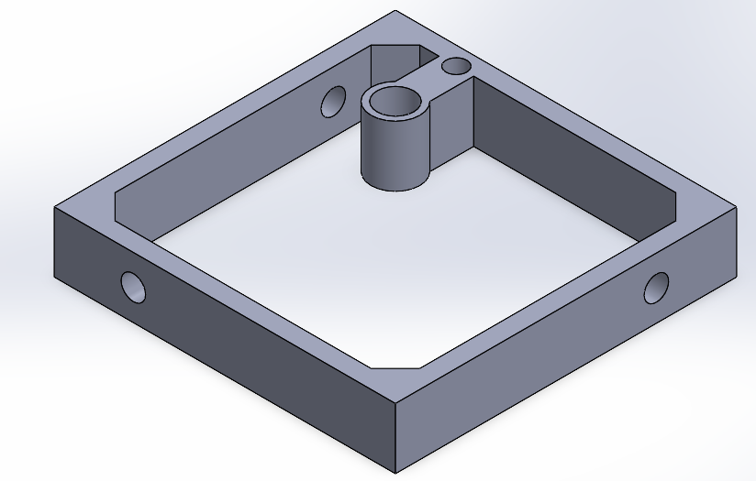
Outer Frame V3:
Threading Hole Diameter = 1 mm
Added support for rigidity
thickness: 0.75 mm
h = 2.5 mm
10 mm

Slide 6
Winner… V2 (can still incorporate the support)

Slide 7
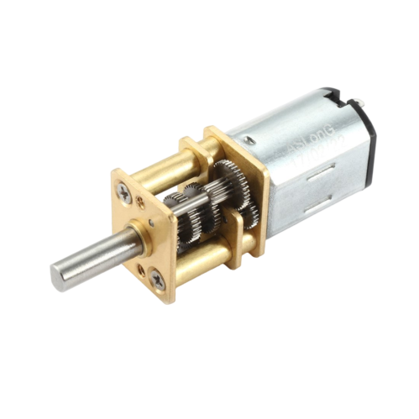
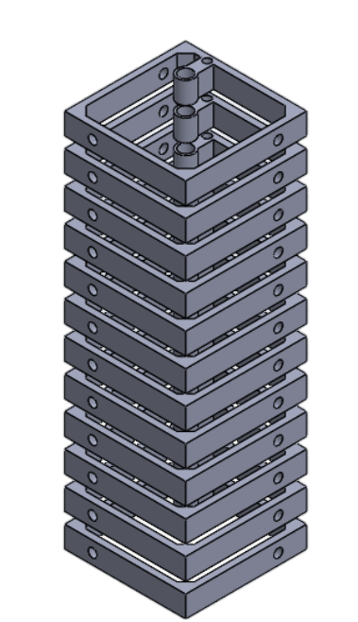
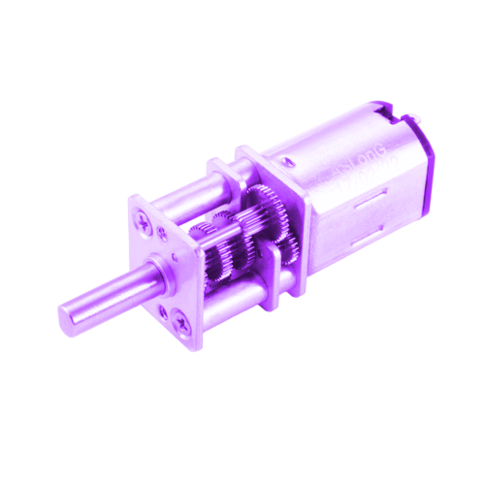
A little worrisome:
Total Height = 12(2.5 mm) + 11(1.25 mm) = 43.75 mm, which may not be that bad (actuation of lowermost frame)

